Slide 1
LOOKING BEYOND our EMOTIONS
“Reinventing library management in the 21st century”
April 20, 2012
Legazpi City

Slide 2
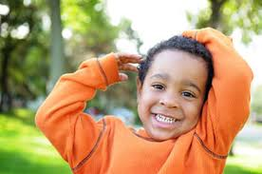
Emotional intelligence involves the “abilities to perceive, appraise, and express emotion; to access and/or generate feelings when they facilitate thought; to understand emotion and emotional knowledge; and to regulate emotions to promote emotional and intellectual growth.”
1997)
(Bar-on, 2002)

Slide 3
Objectives
To discover one’s emotional intelligence.
To share factors that lead to emotionally intelligent person.
To discover one’s stressors in life.
To affirm one’s qualities with the help of others.

Slide 4
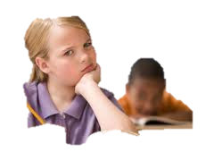
Answer (Emotional awareness questionnaire)
Instruction: Answer Yes, No or Not Sure to those items in your questionnaire.

Slide 5
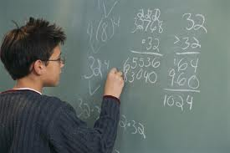
Scoring
Fill-in the table found on the last page of the questionnaire.
Count up the number of YES responses on all questions marked A.

Slide 6
interpretation
NUMBNESS. You haven’t any awareness of your feelings.
PHYSICAL SENSATIONS. Your emotion register physically (e.g. as headaches or dizziness) but you still aren’t aware of the emotions themselves.
PRIMAL EXPERIENCE. You’re conscious of emotions but you don’t know what they are. You can’t discuss them or understand them.
DIFFERENTIATION. By crossing the verbal barrier and talking about your feelings you learn to differentiate between anger, love, shame, joy or hatred.
CAUSALITY. You can not only tell emotions apart, you can also see what causes them.
EMPATHY. You are aware of other people’s emotions.
INTERACTIVITY. You are sensitive to the flow of emotions around you and how they interact.

Slide 7
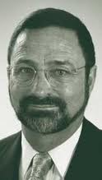
Components of EI (Bar-On,2002)
1. Intrapersonal
2. Interpersonal
3. Stress Management
4. Adaptability
5. General Mood

Slide 8
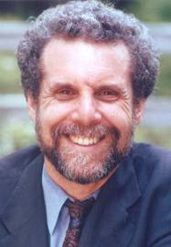
EMOTIONAL COMPETENCE FRAMEWORK (Goleman, 1998)
A. Personal Competence
- Self-awareness
- Self-regulation
- Motivation
B. Social Competence
- Empathy
- Social Skills

Slide 9
DOMAINS OF EMOTIONAL INTELLIGENCE (Salovey & Meyer, 1990)
1. Knowing one's emotions
2. Managing Emotions
3. Motivating oneself
4. Recognizing emotions in
other
5. Handling relationships

Slide 10
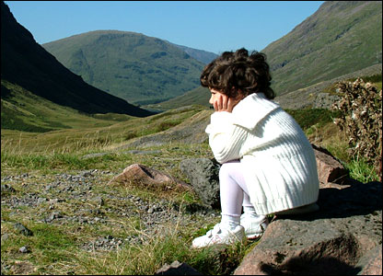
Intrapersonal Abilities
awareness of ourselves and an understanding of our emotions,
the ability to express out thoughts and feelings non-destructively,
the ability to be self-reliant and free of emotional dependency on others; and
the ability and drive to set and achieve our goals.

Slide 11
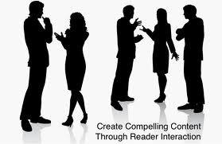
Interpersonal abilities
an awareness of others' emotions, feelings, and needs, and the ability to establish and maintain cooperative, constructive, and mutually satisfying relationships.

Slide 12
Stress Management
refers to the ability to
manage and control
emotions so they work
for us not against us.

Slide 13
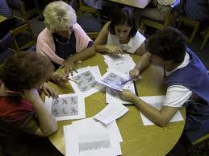
Adaptability
pertains to skills involved in change management.
Managing change involves realistically and flexibly coping with the immediate situation and effectively solving problems as they arise.

Slide 14
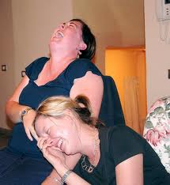
General Mood
an optimistic and positive
outlook combined with
a feeling of happiness
or contentment with
self, others and
life in general.

Slide 15
Strategies
Self-Understanding
Having an accurate and positive view of ourselves
Having a sense of optimism about the world and ourselves
Having a coherent and continuous life story.

Slide 16
Understanding the causes of our emotions includes:
Being aware of the previous events, circumstances, thoughts and past experiences that may have triggered an emotion.
Being aware of what it is all about the current context that may have triggered an emotion.
Being aware of the extent to which our emotions are triggered by factors 'out there' or 'in here'

Slide 17
Understanding Social Situations and Making Relationships:
Forming attachments to other people
Experiencing empathy for others.
Communicating and responding effectively to others.
Managing our relationships effectively.
Being autonomous: independent and self-reliant.

Slide 18
Experiencing, recognizing and accepting the full range of emotions we experience, as they happen to us.
Being aware of the effects of different emotions on our body, on our mood, on our behaviour, and how others around us start to act in response.
Talking openly and accurately about our emotions, including naming the full range of emotions.

Slide 19
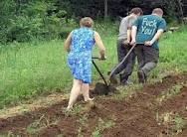
Possible Differences Between Women and Men
Limitations and Vulnerabilities:
Lower self-esteem and less confidence
More likely to see things as outside their control
More likely to suffer from anxiety, depression and self-harm (but not suicide)
More passive and anxious when faced with difficulties
Limitations and Vulnerabilities:
Tendency to become angry when faced with difficulties
Problems with talking about and recognizing feeling in themselves and others
Greater tendency to suicide

Slide 20
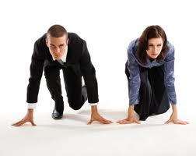
Possible differences of men and women
Women:
More sensitive to feeling
More volatile emotionally
More sensitive about and in relationship
More verbal and articulate about their feelings
More able to see happiness as coming from themselves and other people not from possessions
Men
Focus on things and actions
Better at grasping abstraction
More competitive in relation with others
More likely to see happiness as coming from what people do and achieve such as sporting success or failure
See the world as more within their own control

Slide 21
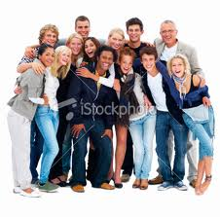
Possible Differences Between Women and Men
Need to work on...
Feeling and expressing anger including the tone, expression and action
Self-confidence and self-esteem
Assertions rather than passivity
Ability to rationalize and see the detail
Need to work on...
Perceiving and understanding relationships
Developing empathy and sensitivity to their own and others' emotional needs
Ability to express sadness and anxiety
Assertion rather than aggression
Ability to see the total picture

Slide 22
Strategies for Intrapersonal Relationship
1. DO NOT compare yourself with others. Practice reaffirming yourself.
2. Keep a personal journal of specific situations
3. Be aware of your feelings and try to understand them.
4. Practice conveying the way you feel to others as well as the reasons behind those feelings.
5. Visualize difficult situations and try to practice how to approach such

Slide 23
Strategies to Improve Interpersonal Relationship
1. Start looking at situations from the perspective of others.
2. Show more concern for others.
3. Do things for others without expecting for returns
4. Examine the nature of your present relations with others, decide what to change.
5. Participate in the social training skills, (groups discussion, play, debate & other group activities.
6. Practice the basic social skills that are vital in building good working relationships.

Slide 24
Strategies to Enhance Stress management skills
1. Be proactive in stressful situations.
2. Prioritize your activities, and don't leave things until the last minute.
3. When you feel stressed, make an effort to breathe deeply and relax your muscles.
4. Make your emotions work for you and not against you.
5. Take “time out” when tension builds up, and do something that you typically enjoy doing.

Slide 25
Strategies to Enhance adaptability skills
1. Practice examining the immediate situations rather than jumping to conclusions.
2. Change your over all approach when your usual way of doing things doesn't work.
3. Brainstorm as many solutions as you can when trying to solve problems.
4. Weigh the pros and cons of the outcomes of each possible solutions before deciding on the best choice.

Slide 26
Strategies to Enhance General Mood
1. Complain less, be more positive, and try to enjoy yourself.
2. Look at the “brighter side” of life.
3. Practice being more optimistic when coping with problems and difficult situations.
4. Base your general approach to things on hope of success rather than fear of failure.
5. Avoid the things that make you sad.

Slide 27
Stress Test
Answer yes or no to the following questions:
1. Do you worry about the future?
2. Do you sometimes have trouble falling asleep?
3. Do you often reach for a cigarette, a drink, or a tranquillizer in order to reduce tension?

Slide 28
4. Do you become irritated over basically
insignificant matters?
5. Do you have less energy than you seem to need or
would like to have?
6. Do you have too many things to do and not
enough time to do them?
7. Do you have headaches or stomach problems?

Slide 29
8. Do you feel pressure to accomplish or get things done?
9. Are you very concerned about being either well liked or
successful?
10. Do you perform well enough in life to satisfy yourself?
11. Do you get satisfaction from the small joys or simple
pleasures of life?
12. Are you able to really relax and have fun?

Slide 30
Scoring
Give yourself one point for each question 1-9 with yes response and one point for each question 10-12 with NO response.
If your score is four or more, then you may be under significant stress. You may want to find more about managing stress.

Slide 31
Research
Ollendorf , M. (1989). How much do librarians know about stress management?
Finding: That there is a need for stress management training for librarians.

Slide 32
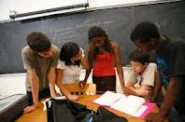
STRATEGIES FOR STRESS MANAGEMENT
Associate with people whom you enjoy.

Slide 33
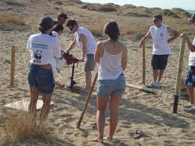
Engage in various physical
exercise that is convenient
and pleasurable.
Sometimes it helps
a friend to exercise
with you.

Slide 34
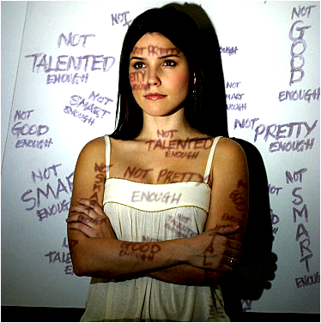
Don’t let one thing dominate you, such as school work, relationships, jobs, sports, etc.

Slide 35
Take responsibility
for your life
and your feelings,
but never
blame
yourself.

Slide 36
Maintain a reasonable diet and sane sleep habits.

Slide 37
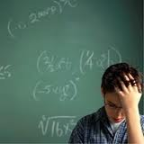
Avoid the use of sleeping pills, tranquilizers, and other drugs to control stress

Slide 38
Protect your personal freedom.

Slide 39
Find a time and place each day where you can have complete privacy.

Slide 40
Surround yourself with cues from positive thoughts and relaxation

Slide 41
Review your obligations from time to time and make sure they are still good for you. If they’re not let them go.

Slide 42
Open your self to new experiences. Try new things, new food and new places.

Slide 43
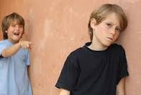
When worry start to build up, talk to someone.

Slide 44
Learn and practice relaxation or meditation skills

Slide 45
Content
Understanding
Communication
Problem
Solving
Working
Metacognition
Collaboration
CRESST Model of Learning, Baker (1995)

Slide 46
Describe results of any experiences that you have with keeping a journal and/or diary.
Notes:
We know that learning requires some type of motivation. Why are you here in this workshop to learn about learning? I would guess that you “value” learning and desire to know everything there is to know about doing it better. OK, so you are motivated to be here to engage in the learning process – now what do you already know about learning that would optimize your experience today?

Slide 47
Problem Solving
Content
Understanding
Domain-Dependent
Problem Solving
Strategies
Self-Regulation
Metacognition
Motivation
Awareness
Self-efficacy
Planning
Effort
Monitoring
Cognitive Strategies
http://www.cse.ucla.edu/CRESST/Files/downloads/CRESST/AASADAY1/9/ONeill.ppt

Slide 48
“How do we acquire and process knowledge?”
Declarative: “What” skills/strategies do I have?
Procedural: “How” do I use these skills/strategies?
Conditional: “When and Why” would I use these skills and strategies?
Notes:
We use three ways to process knowledge. First we must define what strategies that we have available to us, then we must decide how to use those strategies—which may involve heuristics that we have learned and finally we must confirm when and why we should use those specific strategies. Let’s take a look at some examples which may help to bring a clearer picture of these components.

Slide 49
Metacognition
Knowledge of Cognition
Positive affect of:
Emotions
Attitudes
Motivation
Selects working strategies
WORKER
Helps Control Working
Regulation of Cognition
Access previous knowledge

Slide 50
Ways for developing METACOGNITIVE STRATEGIES
Identifying “what you know” and “what you don’t know”
Talking about thinking
Keeping a thinking journal
Planning and self-regulation
Debriefing the thinking process
Self-evaluation

Slide 51
Taking Control of Learning
“Your learning is going on inside your head, and is dependent on what you are feeling like, what you already know, and the way you approach the whole experience of learning.”
Ian McDonald
Swinburne University
Australia
Notes:
Ian McDonald simplifies the learning process in this way:

Slide 52
Learned helplessness theory is the view that clinical depression and related mental illnesses result from a perceived absence of control over the outcome of a situation (Seligman, 1975).

Slide 53
What is learned helplessness?
Learned helplessness as a technical term in animal psychology and related human psychology means a condition of a human being or an animal in which it has learned to behave helplessly, even when the opportunity is restored for it to help itself by avoiding an unpleasant or harmful circumstance to which it has been subjected.

Slide 54
Learned helplessness and children
Learned helplessness is caused by parents and or the children's teacher (s). They both might indicate that the child's failures are caused by their lack of competence, rather than suggesting that they are not trying hard enough (Cullen &Boersma, 1982).

Slide 55
Csikszentmihalyi's Flow Channel
High
Anxiety
Favorite Activity “Flow”
CHALLENGE
Apathy
Boredom
Low
Low
SKILLS
High

Slide 56
Flow Theory
is also called “Optimal Experience”.
the holistic experience that people feel when they act with total involvement.
the state in which people are so involved in an activity that nothing else seems to matter.

Slide 57
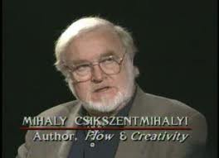
Flow theory
A sense of that one’s skills are adequate to cope with the challenges at hand in a goal directed, rule bound action system that provides clear clues as to how one is performing.

Slide 58
References on Metacognition
Burrows, V.A., McNeill, B., Hubele, N.F., Bellamy, L. (2001) “Statistical Evidence for Enhanced Learning of Content through Reflective Journal Writing,” Journal of Engineering Education, pp. 661-667
Cowan, J. (1998) On Becoming an Innovative University Teacher: Reflection in Action. Buckingham: SRHE and Open University Press.
Gourgey, AF (2001), Metacognition in Basic Skills Instruction. In Metacognition in Learning and Instruction, Hartman, HJ (ed), p17-32.
Hartman, HJ (2001), Developing Students’ Metacognitive Knowledge and Skills. In Metacognition in Learning and Instruction, Hartman, HJ (ed), p33-68.
McDonald, I (in press), Taking Control of Learning, Centre for LATTES, Swinburn University
Novak, JD (1998), The Pursuit of a Dream: Education Can Be Improved. In Teaching Science for Understanding: A Human Constructivist View, p3-28
Schraw, G (2001). Promoting General Metacognitive Awareness. In Metacognition in Learning and Instruction, Hartman, HJ (ed), p3-16.
Sternberg, RJ (2001). Metacognition, Abilities, and Developing Expertise: What Makes an Expert Student? In Metacognition in Learning and Instruction, Hartman, HJ (ed), p247-260.
Svinicki, MD (1999). New Directions in Learning and Motivation. In Svinicki, MD(Ed.), College Teaching: From Theory to Practice. New Directions for Teaching and Learning, 80, 5-27

Slide 59
References EQ Annamalay, S. (2000). Child’s emotional intelligence. Malaysia: Times Tubang. Cohen, J. (1999). Educating minds and hearts. Virginia: ASCD. Goleman, D. (1998). Working on emotional intelligence. New York: Publishing History. Goleman, D. (1995). Emotional intelligence. New York: Publishing History. Weare (2004). Developing the emotionally literate school. London: Paul Chapman Pub.

Slide 60
Thank you!!!

